Slide 1
H-1B Visa Application Data Analysis
SPRIHA BATAR | CIN: 305053299
PREMDEEP PARASA | CIN: 305094210
SUMANI PIDIKITI | CIN: 305065103
HASITHA REDDY PITTU | CIN: 305084421

Slide 2
Synopsis
Introduction
Tools Used
Dataset Specifications
Workflow
Detailed Analysis of H-1B Visas
Conclusion
Github Details
References

Slide 3
Introduction
H-1B is a non-immigrant visa which allows American employers to hire foreign employees to work for them.
Over 1.7 Billion H-1B applications were analyzed.
Various categories of statuses: Certified, Denied, Withdrawn, etc.

Slide 4
Tools Used
Databricks
Microsoft Excel 2016

Slide 5
Work Flow
Data is downloaded in .csv format.
Databricks aims to helps with cloud-based big data processing.
Cluster is created on Databricks and the data is uploaded.
Data is put into a table and using a notebook, queries were executed.
Visualization is done on the result of the queries.
.csv files
Databricks
Upload data
Create Table
Visualization

Slide 6
Dataset
The data was downloaded from an online repository. https://app.enigma.io/table/us.gov.dol.oflc.h1b.2011?search[]=(%22international%22%20%22student%22)
Size of the dataset: around 600 MB.
In .csv format.
The dataset contains the data from 2011 to 2014.

Slide 7
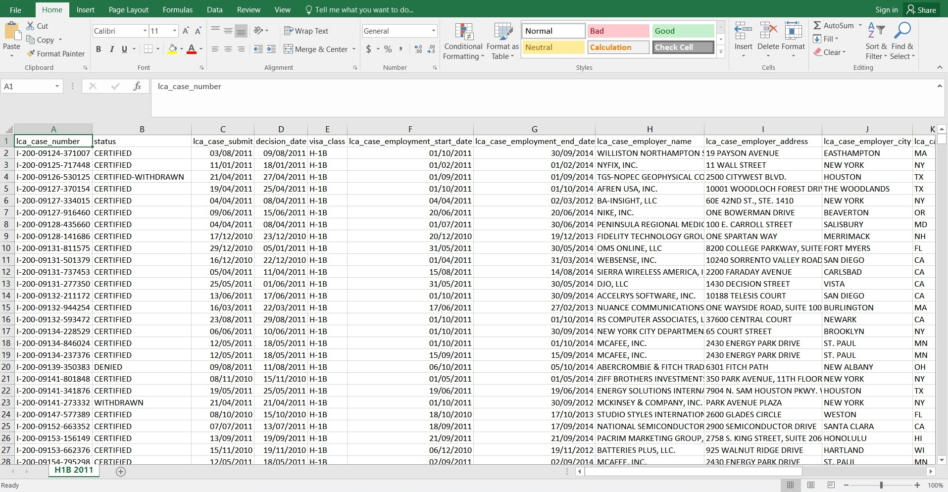
Dataset

Slide 8
Databricks Cluster Details
Cluster Type – Hadoop 1
Memory – 6 GB
Version – Spark 1.6.1
Number of Nodes – 5
Drivers – 0.88 Cores

Slide 9
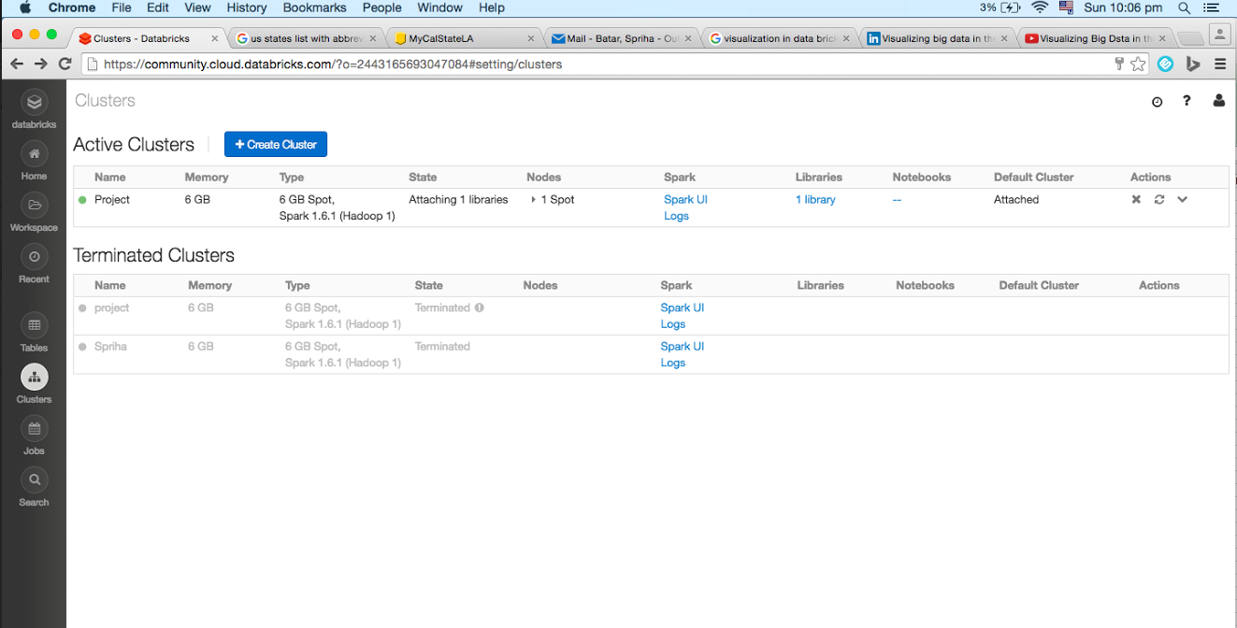
Databricks Cluster

Slide 10
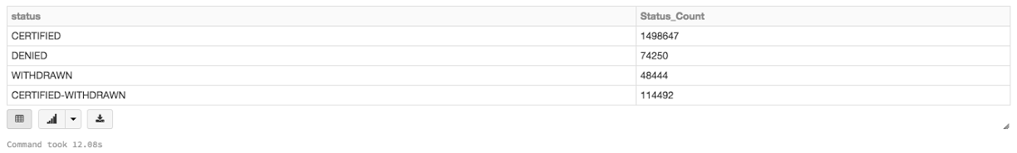
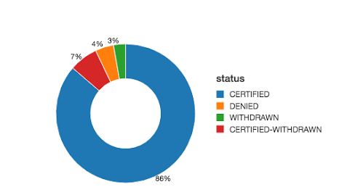
Different Types Of Visa Status select status, count(status) as Status_count from project1 group by status;

Slide 11
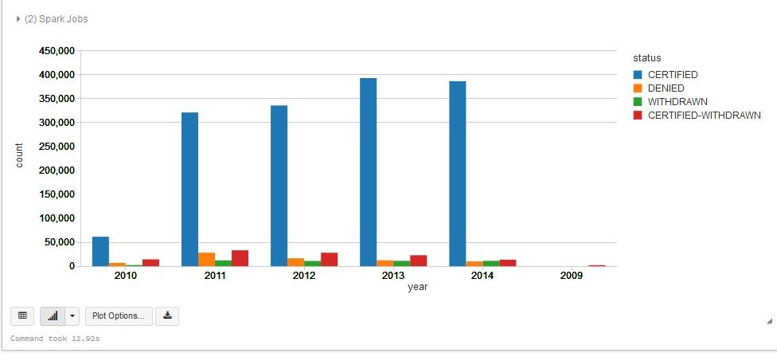
Year wise Application Statuses select status, year(lca_case_submit) as year, count(status) as count from project1 group by status, year(lca_case_submit);

Slide 12
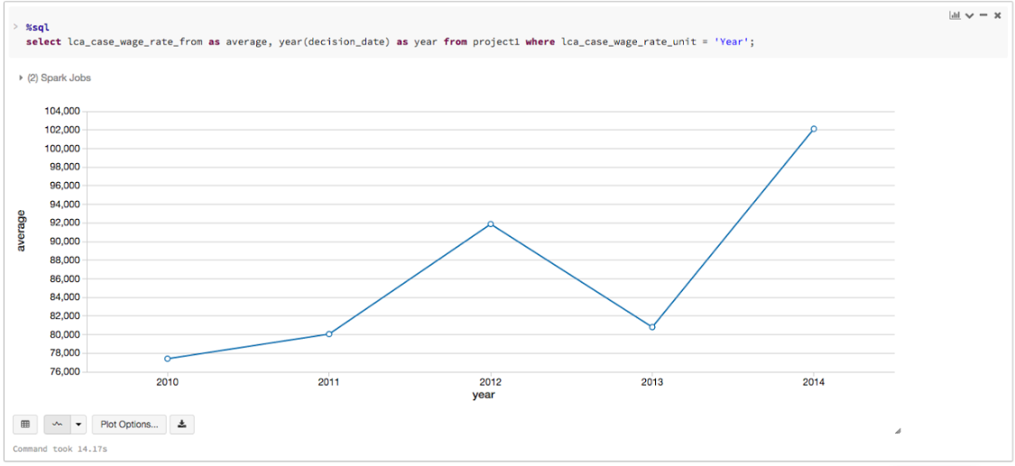
Average Starting Wage Of Employees Per Year select lca_case_wage_rate_from as average, year(decision_date) as year from project1 where lca_case_wage_rate_unit = ‘YEAR’;

Slide 13
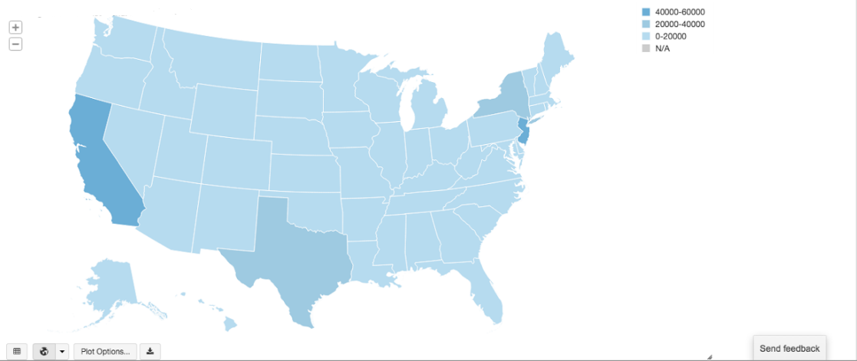
Intensity Of Visa Applications In Each State select lca_case_employer_state, count(lca_case_employer_state) as State_Count from project1 group by lca_case_employer_state;

Slide 14
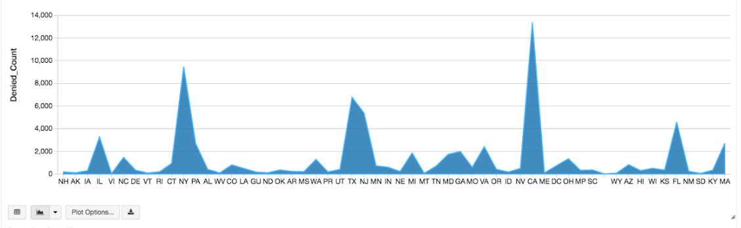
No. of Applications Denied By Different States select lca_case_employer_state, count(status) as Denied_Count from project1 where status=‘DENIED’ group by lca_case_employer_state, status;

Slide 15
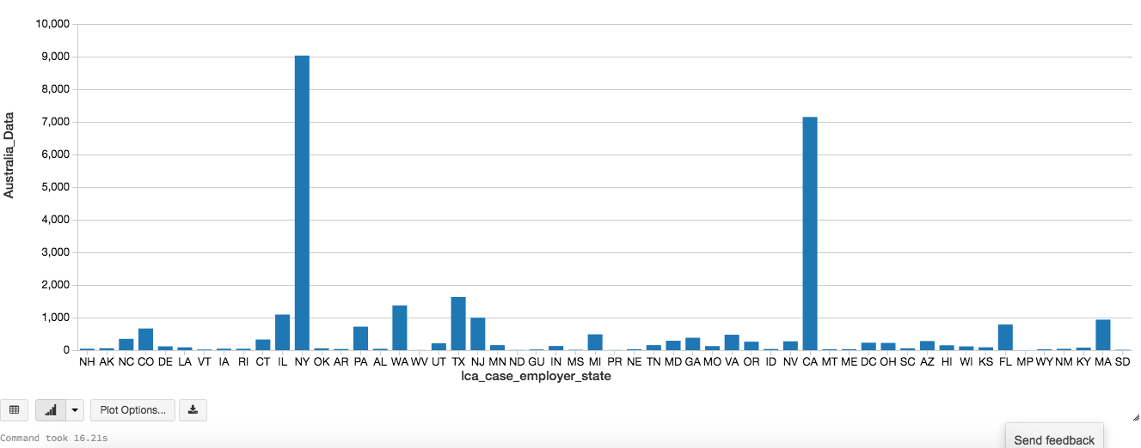
Visa Applications of Australian Employees select lca_case_employee_state, count(status) as Australia_Data fro project1 where visa_class = ‘E-3 Australian’ group by lca_case_employer_state, status;

Slide 16
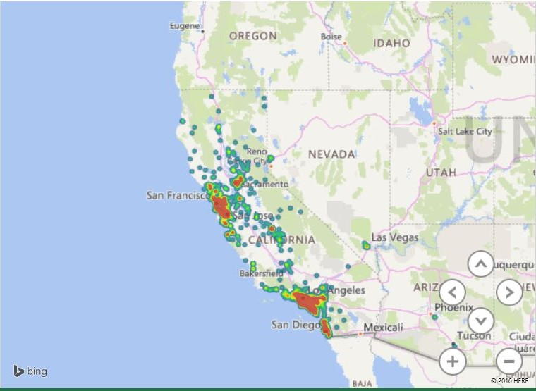
Intensity of Applicants from California State select lca_case_employer_postal_code from project1 where lca_case_employer_state = 'CA‘;

Slide 17
Conclusion
Majority of the visa applications that are filed are certified (86%). Very few of the applications were withdrawn(3%) and denied(4%).
Significant growth in application certified and decline in denials each year.
The highest wage rate for employees working on H1B visa was noted in the year 2014. (Around 100K). There was a dip in the year 2013 where it fell to around 80K.
The maximum applications were filed from the state of California and New Jersey. Texas and New York were next in line.

Slide 18
Conclusion (cont..)
The rejections were also seen high in California, New York, New Jersey and Texas.
The Australian employees majorly worked for employers in New York and California.
Most number of applications from California are from Los Angeles followed by San Francisco and San Diego.
On basis of our analysis, we found that the employees coming from different parts of the world, prefer working in the states of California and New York.

Slide 19
GitHub and Data Set Details
Data:
https://app.enigma.io/table/us.gov.dol.oflc.h1b.2011?search[]=(%22international%22%20%22student%22)
GitHub:
https://github.com/pparasa/H1B-Applications-Data-Analysis

Slide 20
References
https://www.safaribooksonline.com/library/view/mastering-apache-spark/9781783987146/ch08s10.html
https://databricks.com/blog/2015/06/22/understanding-your-spark-application-through-visualization.html
https://www.youtube.com/watch?v=xAQQClV3k1E

Slide 21


